Slide 1
Extreme Sports Startup

Slide 2
Project overview
Objective: Establish an innovative snowboarding brand with a focus on safety, performance, and customization.
Approach: Start a multi-channel marketing campaign including social media, email, influencer collaborations, and SEO.
Introducing Camber and Rocker boards with carbon fiber technology, dealing with the issue of edge catching.
Offering customizable sizing options to fulfill diverse consumer needs.
Simplifying snowboard selection process by making it easy for consumers to choose from different snowboard types.
Brand Messaging: Promoting the idea of enjoying adrenaline rush without compromising on comfort and safety.
Execution: Sequential approach beginning with SEO and email marketing, followed by content creation, influencer collaborations, and ongoing optimization.

Slide 3
Objective
Brand awareness is the main goal of our campaign because we want lots of people to know about our new snowboarding brand.
We'll show off how our boards are special, like how you can pick your own size and they're made with new technology to stop you from falling over.
Choosing to be present on social media and live in ski resorts, launching events will be costly, but our brand will be visible and that might be a great start.

Slide 4
Target audience
Our brand is based in Europe so we’re targeting Europe geographically, most snowboarders are males between 22 and 35 years. Since snowboarding as sport is quite costly, we aim for above average household income
Buyer persona
Name: Alex
Age: 28
Location: Berlin, Germany
Background: A graphic designer who loves snowboarding and outdoor adventures.
Interests: Snowboarding, Outdoor adventure, Technology
Goals: Improve skills, Stay safe while learning new tricks
Challenges: Finding the right snowboard, Edge catching
How our brand can help: Customizable sizes, Advanced technology ensuring safety

Slide 5
Key messages
We're making snowboarding easier and safer so you can have more fun. Our boards let you go fast and do cool tricks without worrying about catching an edge. You don't have to be an expert to use them - even beginners can feel like pros with our boards, just like the ones you see in the X-Games
There are plenty snowboard designs, just wait until you stumble on the ones you like and can’t find the right size… Choose any design you love, and we'll craft it in the size that fits you just right. Confused about the different types of snowboards like All-mountain, Freestyle, or Freeride? Skip the hassle of Googling and let us guide you with simple questions about your riding preferences. Find your ideal snowboard hassle-free on our 'Snowboards for you' page.

Slide 6
Deliverables
With our main focus on Instagram we will have lots of videos, pictures and UGC content reposts on our page. Also pictures of some deals (snowboard and price visible). We will run sponsored posts on Instagram as well. We’ll test videos >10s, 10-30s, <30s. For pictures we will try single pictures, carousels and we will double down on what’s working. Stories won’t be too promoting, casual videos of our snowboards or ski resorts.
Tiktok will have plenty of organic videos, including our ads and UGC content. We will run paid Tiktok ads as well. Need to check format and length of competitors of what’s working for tiktok ads. If any of our organic videos go viral, we will repurpose them to Tiktok paid ads. We will skip the most common stage of “Broad audience targeting” as our product is quite specific and it has its own audience.
Snowboarding influencers will post their clips with our snowboards on their instagram/tiktok (we will repost some of them on our page)
Email campaigns will have 3 categories: offers for the newsletter subscribers, for those who abandoned cart and for those who made a purchase already.
We will make reviews, specifications overview videos on Youtube, explaining what snowboard fits best for different style riders. Videos will be average duration, 3-6min each.

Slide 7
Tone and Style
Casual and confident tone with an energetic style fits well a snowboarding brand. We want our brand to feel like a friend who's excited to hit the slopes with you. By keeping things relaxed yet confident, we can share our passion for snowboarding while inspiring our audience to feel the same enthusiasm. This tone makes it easy for snowboarders to connect with us and share in the excitement of the sport.

Slide 8
Budget and schedule
The marketing budget is 500 000 EUR, while allocating 350 000 EUR towards performance marketing.
Since we have different teams for email marketing, social media, content creators and influencer marketers, all of the processes involved with deliverables developing and launching will happen simultaneously. As it’s completely new campaign and no such campaigns were launched by our brand, we can set the timeline 2 months for developing and launching the campaigns.
Although we can’t forget we need to shoot footage of our snowboards on the slopes, meaning that has to be done before the skiing season starts (because we want to launch our campaign before the season starts or at least early in the season - roughly November). So getting the shots and editing them might take longer and this could be first task, not solely depending on the campaign launch. This could be done over 1 month period and older shots from previous seasons can be used as well.
So shooting the footage + develop and launch campaign will take 3-4 months.

Slide 9
Success metrics
We will mostly measure website traffic to see how beneficial our influencer and affiliate marketing is, also if our SEO is doing good. This will be done with the help of Pixels installed on our website and tools like AHrefs, SEMrush.
Measuring social media engagement will be crucial, as once again - our main focus is Instagram because of our target audience presence of that platform. This will be done with tools that track social media campaigns success.
Conversion rate, CTR, CPM, CPV, AOV, Email open rate, ROAS and so on have to be measured as well of course, as knowing these metrics might direct us towards double downing on a specific campaign or vise versa - shutting it down if it’s not working. All these metrics can be found on our website, we can filter by traffic type, time of day, location, etc. to get more insights.

Slide 10


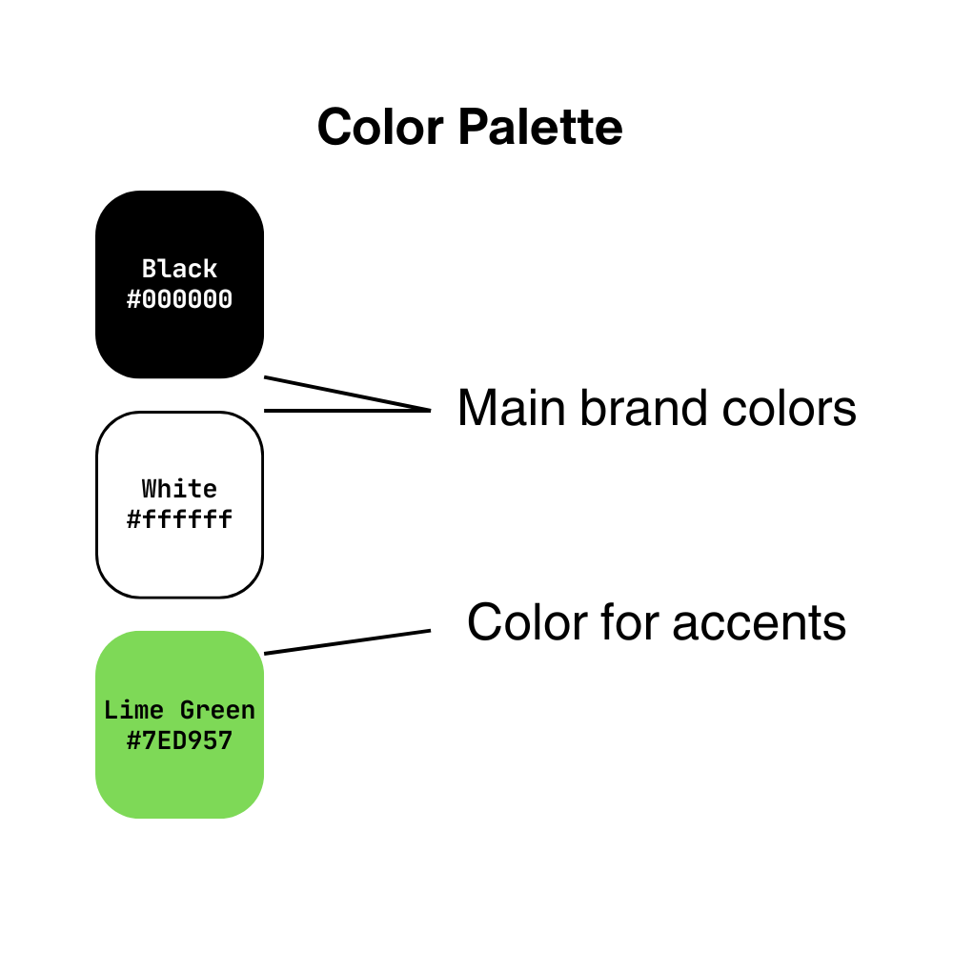
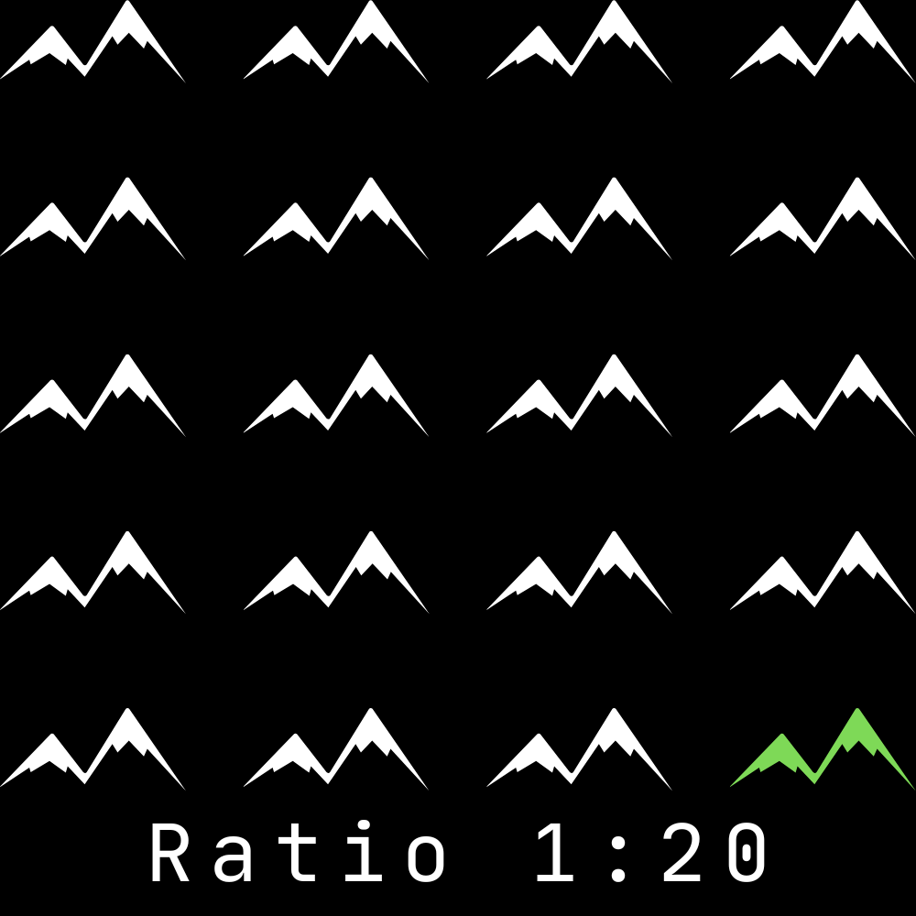
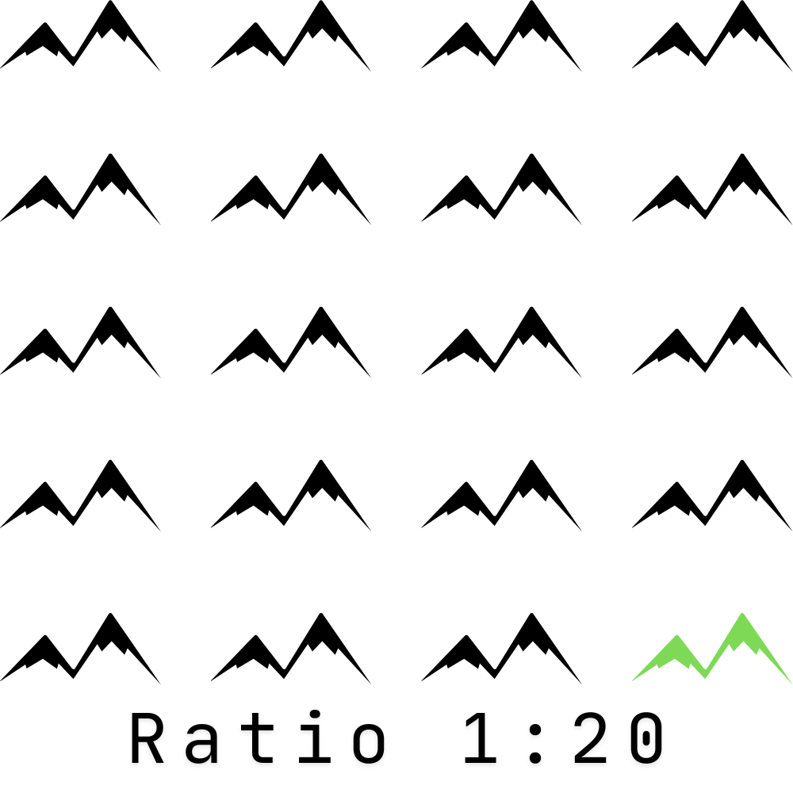
Brand Visuals

